Slide 1

VE300 Technical Communication
Week 7
Professional Correspondence
Michele Campbell
Summer 2020

Slide 2
Common E-mails for JI Students
Current professors in JI
Questions about lectures and homework
Lab work: applications for lab assistant, reports of the day’s work
Future advisers in graduate program
Procedural questions: credits, policies, application process and materials (such as TOEFL, transcripts, proof of funding)
Internships and full-time Jobs
Reports on job performance
Requests for info from other departments (internally)
Requests for support or cooperation from other companies (externally)

Slide 3
Features of an E-mail
Addressee | Recipient, carbon copy (CC), blind carbon copy (BCC)
Subject line | Detailed, precise, and specific
Content | Well-organized into coherent paragraphs
Signature | Add your position and institution, when appropriate
Attachments | Don’t forget to attach them!

Slide 4
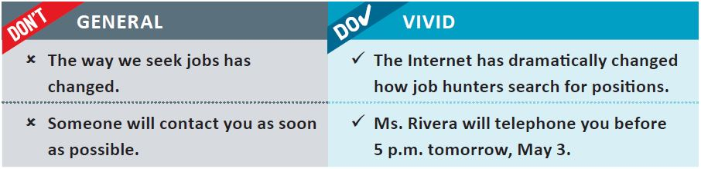
Specificity
Source: Guffey & Loewy, 2016, p. 72

Slide 5
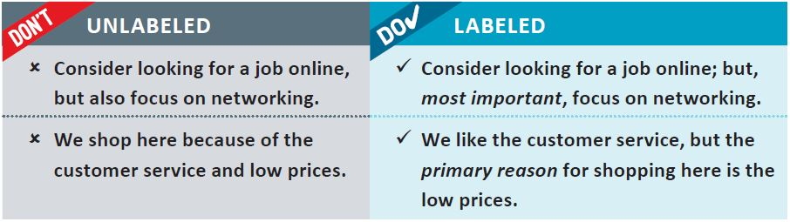
Labeling
Source: Guffey & Loewy, 2016, p. 72

Slide 6
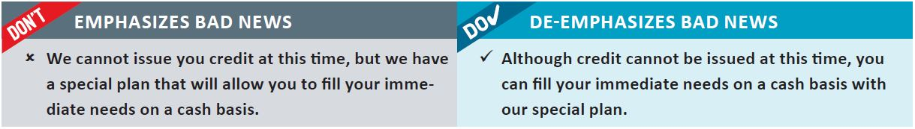
De-Emphasis
Source: Guffey & Loewy, 2016, p. 73

Slide 7
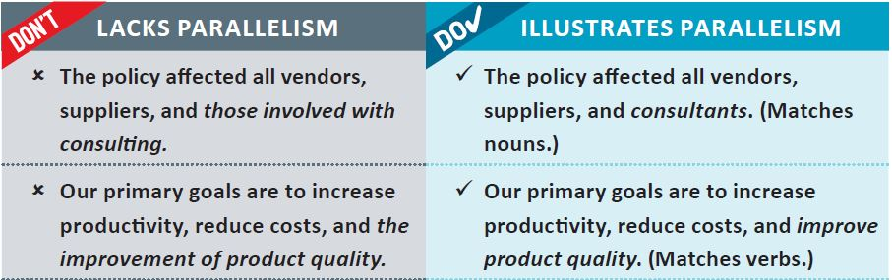
Parallelism
Source: Guffey & Loewy, 2016, p. 74

Slide 8
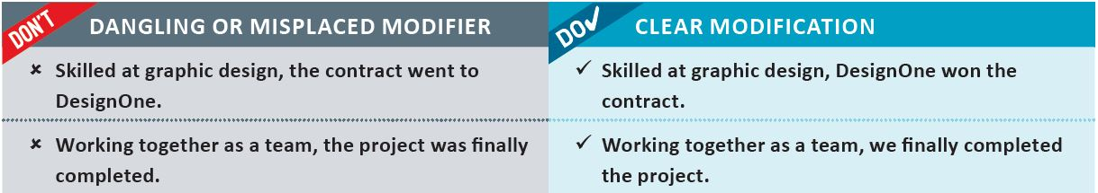
Misplaced Modifier
Source: Guffey & Loewy, 2016, p. 75

Slide 9
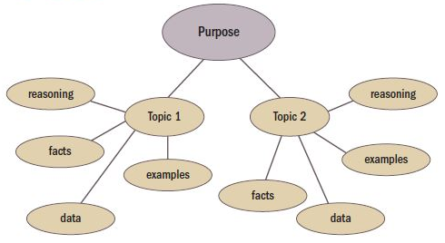
Drafting an e-mail
Introduction
Subject
Purpose
Main point
Background information
Importance of the subject
Body
Conclusion
Thanking reader
Restating main point
Looking to the future
Source: Johnson-Sheehan, 2015, p. 103

Slide 10
Characteristics of a Good E-mail
Subject line indicates content of message
Opens with a friendly greeting or thank you
Well organized, which each paragraph having one central focus
Closes with a concrete request or action statement
Has a professional tone, avoids being too humorous in case it might be offensive

Slide 11
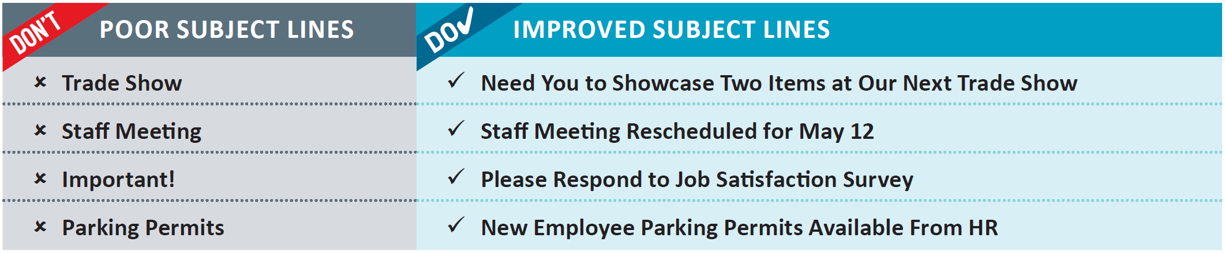
Subject Line
Source: Guffey & Loewy, 2016, p. 122

Slide 12
